Slide 1

Final Presentation
International Trade
Exploration & Prediction
Using Knowledge Graph
with respect to USA
Tejas Bharambe
Soojung Choi
University of Southern California
DSCI558

Slide 2
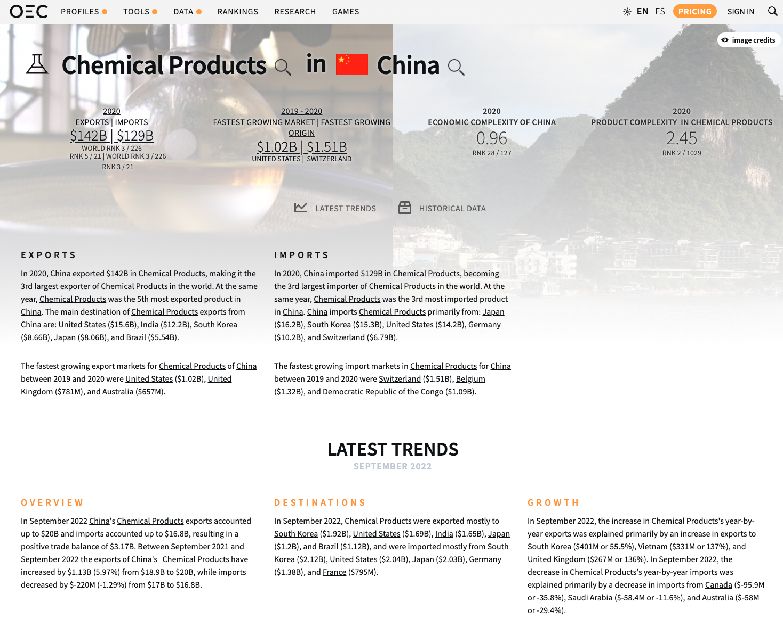
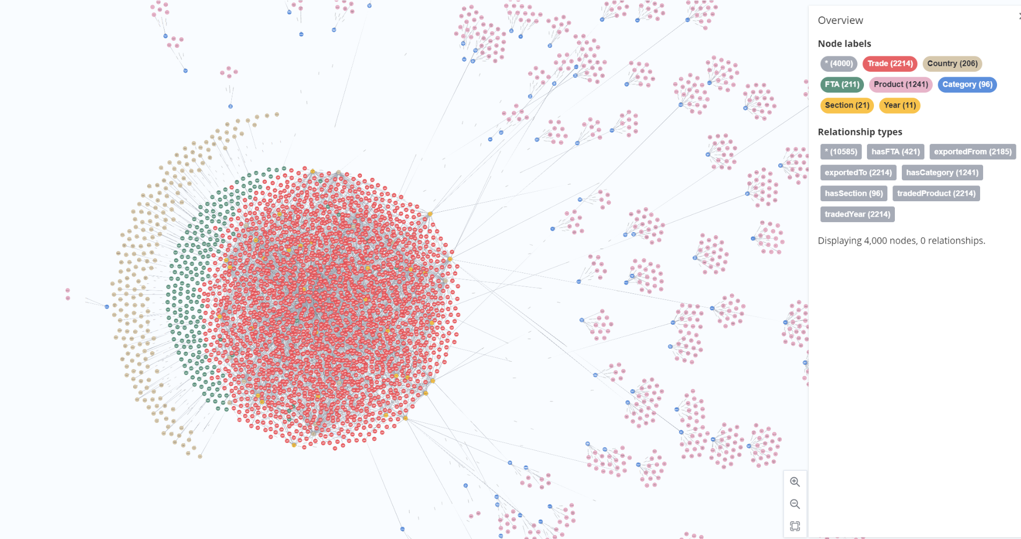
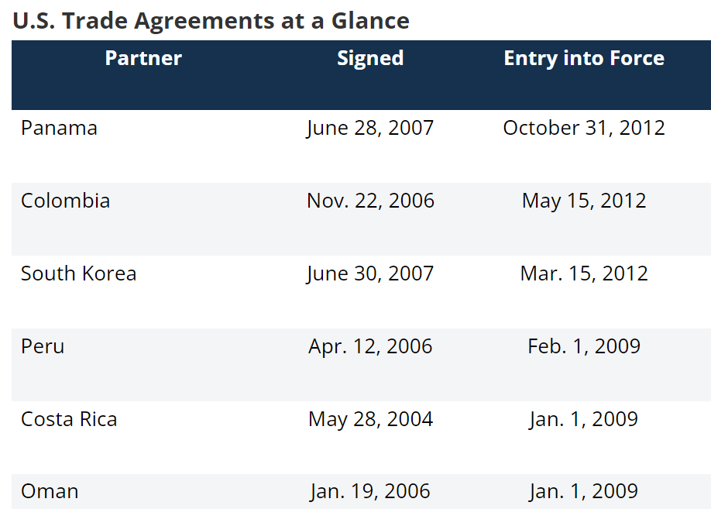
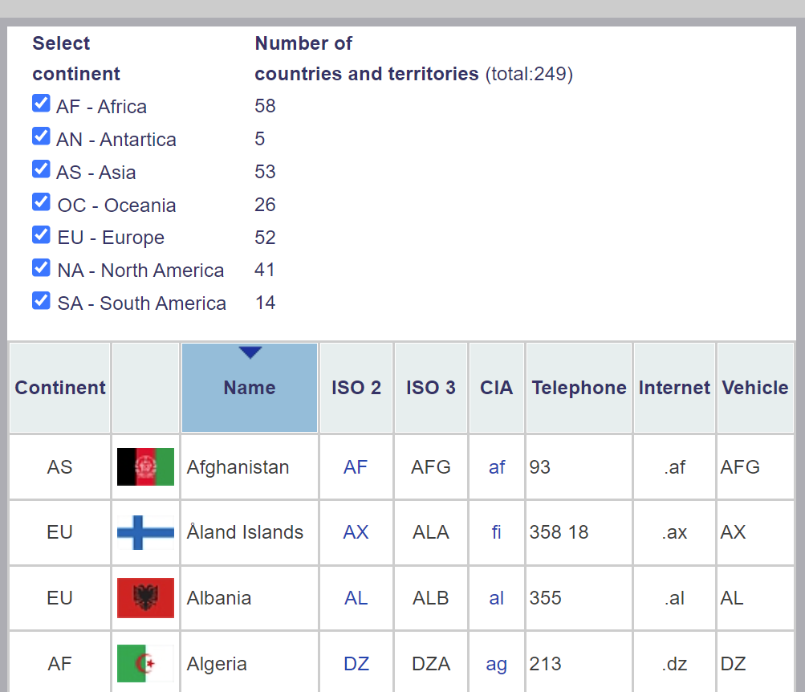
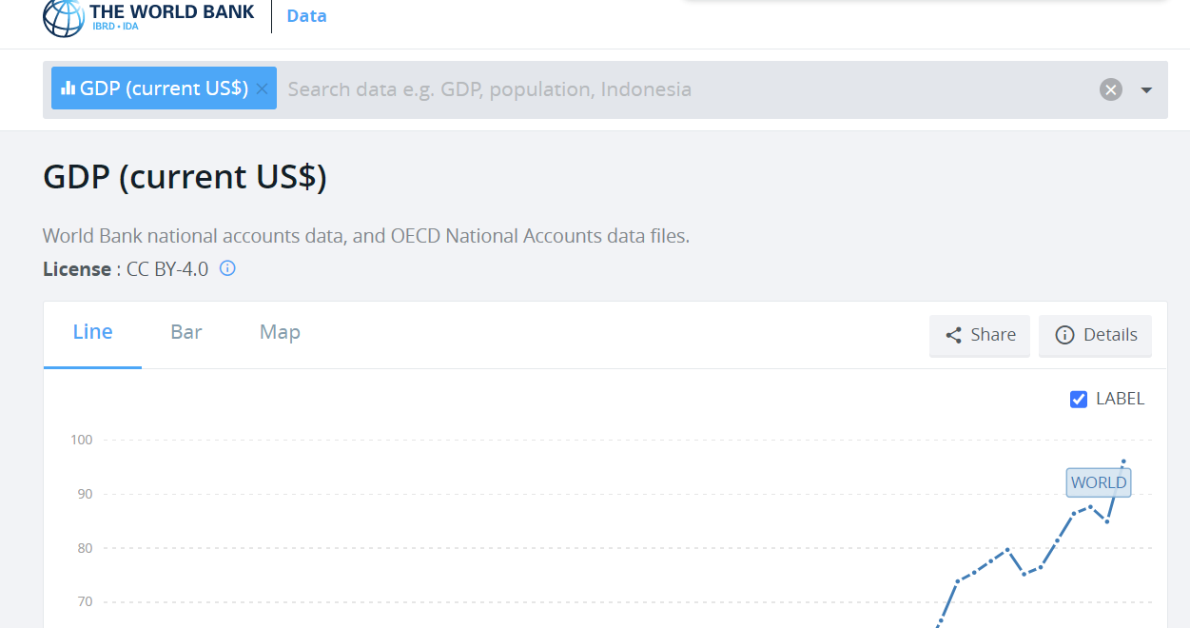
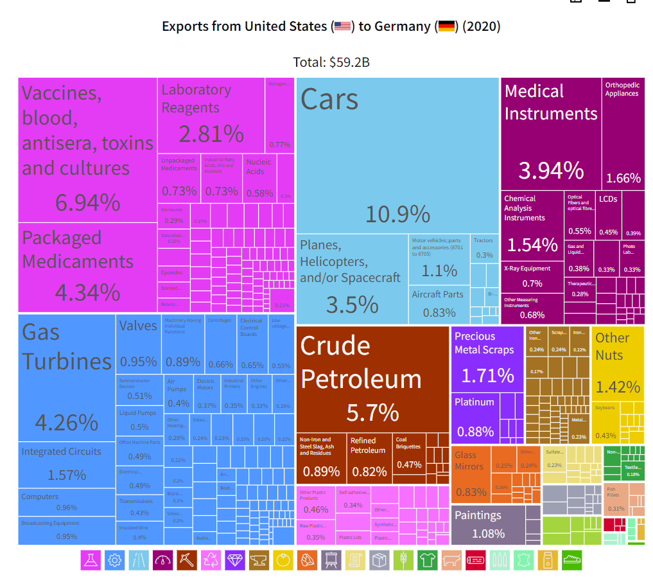
Motivation | Why do we need KG for this?
Currently, Trade related data is Everywhere and Messy
Messy Data
Into One Place in a Fast Accessible Format

Slide 3
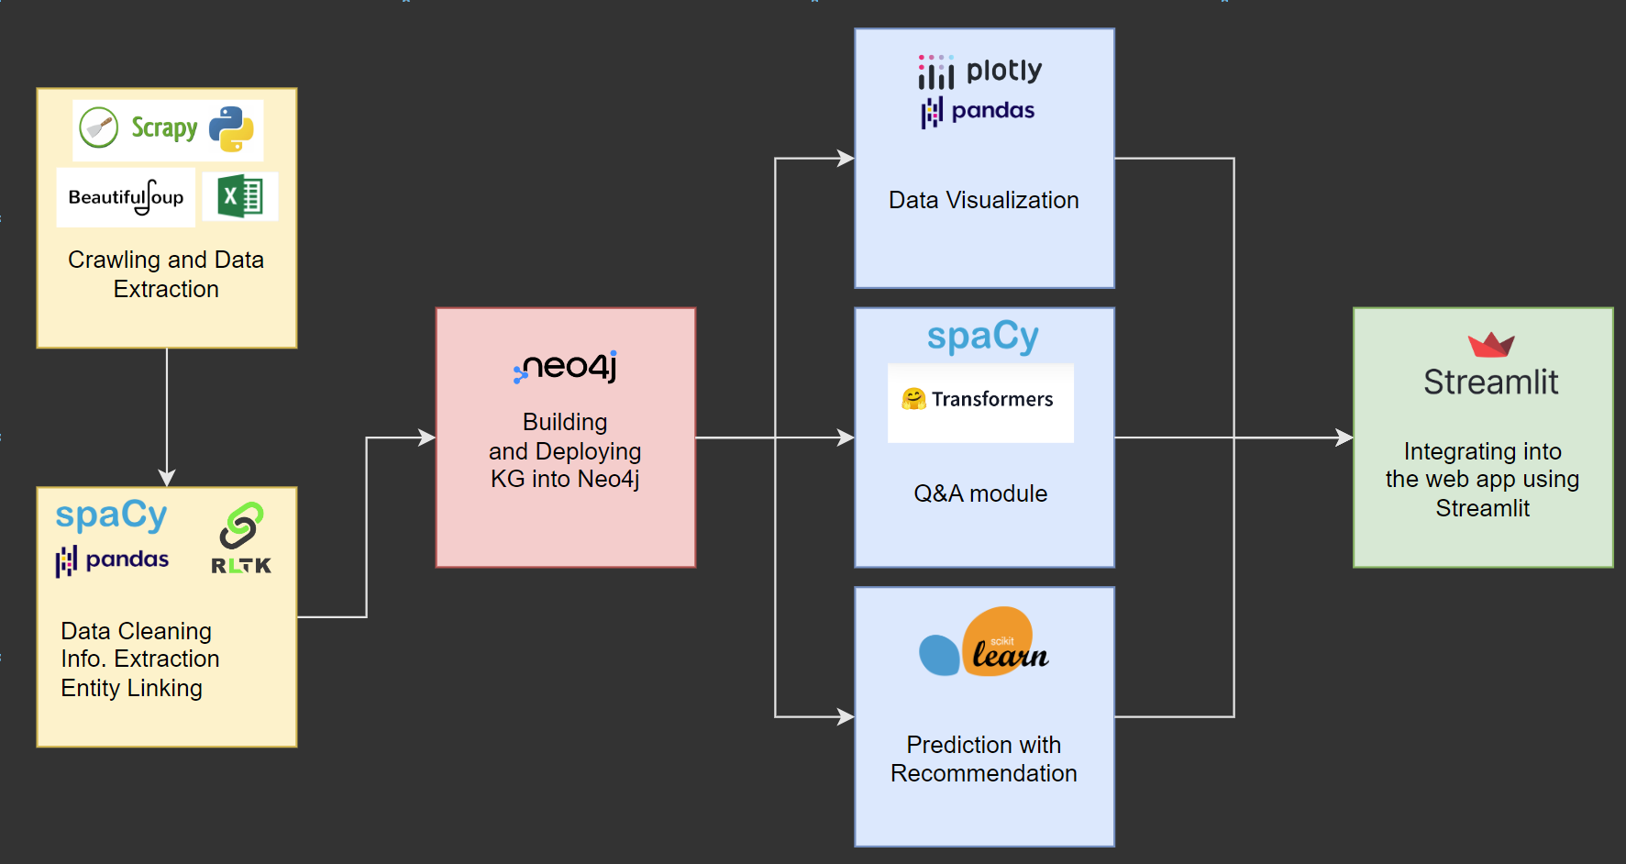
Overview

Slide 4





Preparation | Data Sources
Trade Related Data
Country Related Data
Data about:
Countries
Products
Category of Products
Section of Categories
Trade Values
Type: Unstructured
#Records: ~35M
Format: Charts, Text & Links
Data about:
GDP
Population
Type: Structured
#Records: ~13.5k
Format: Tabular
https://data.worldbank.org/
https://oec.world/
FTA Data
Country Code Data
Data about: FTA with US
Type: Structured
#Records: 20
Format: Tabular
Data about: Country Codes
Type: Structured
#Records: 250
Format: Tabular
www.state.gov/trade-agreements/existing-u-s-trade-agreements/
https://country-code.cl/

Slide 5



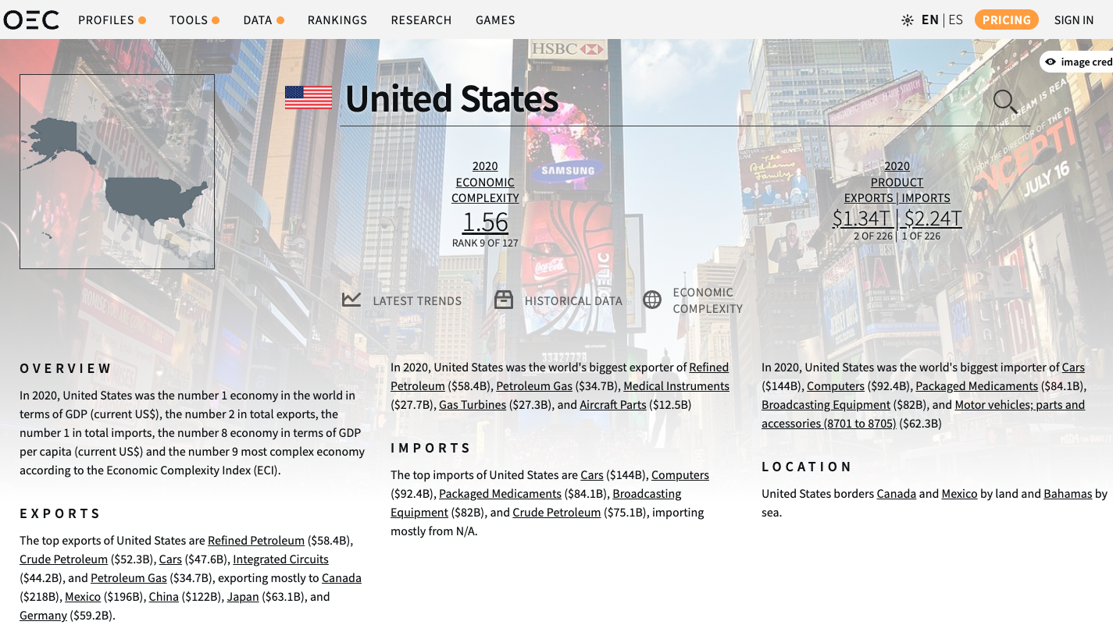
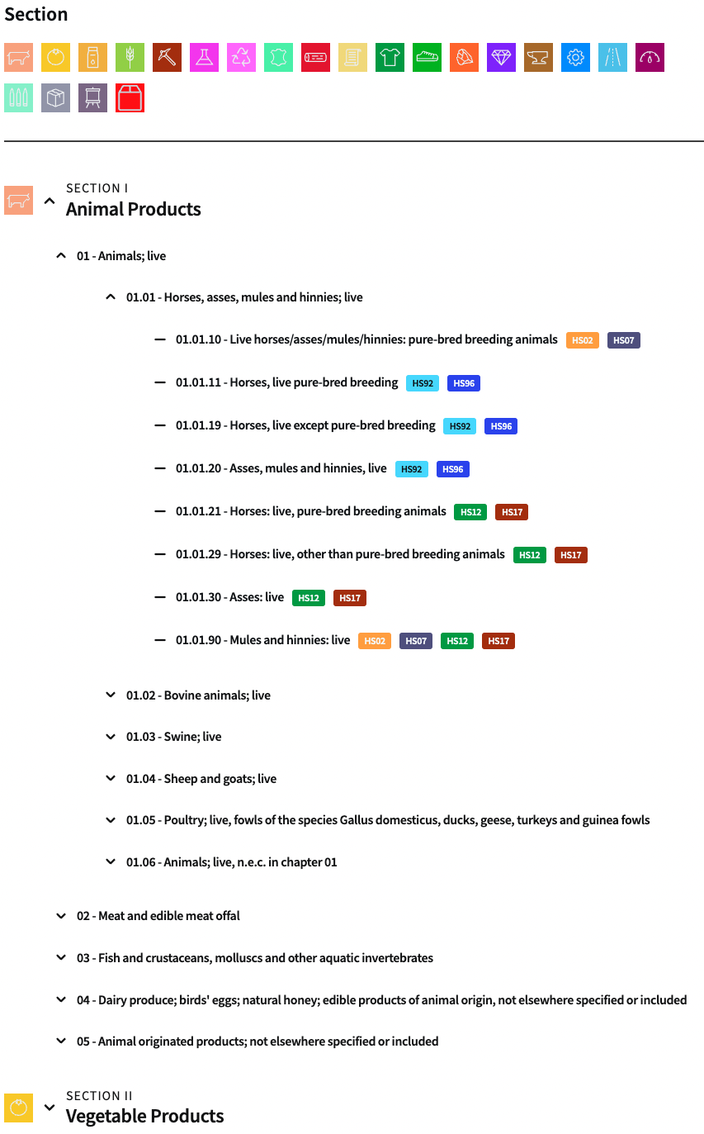
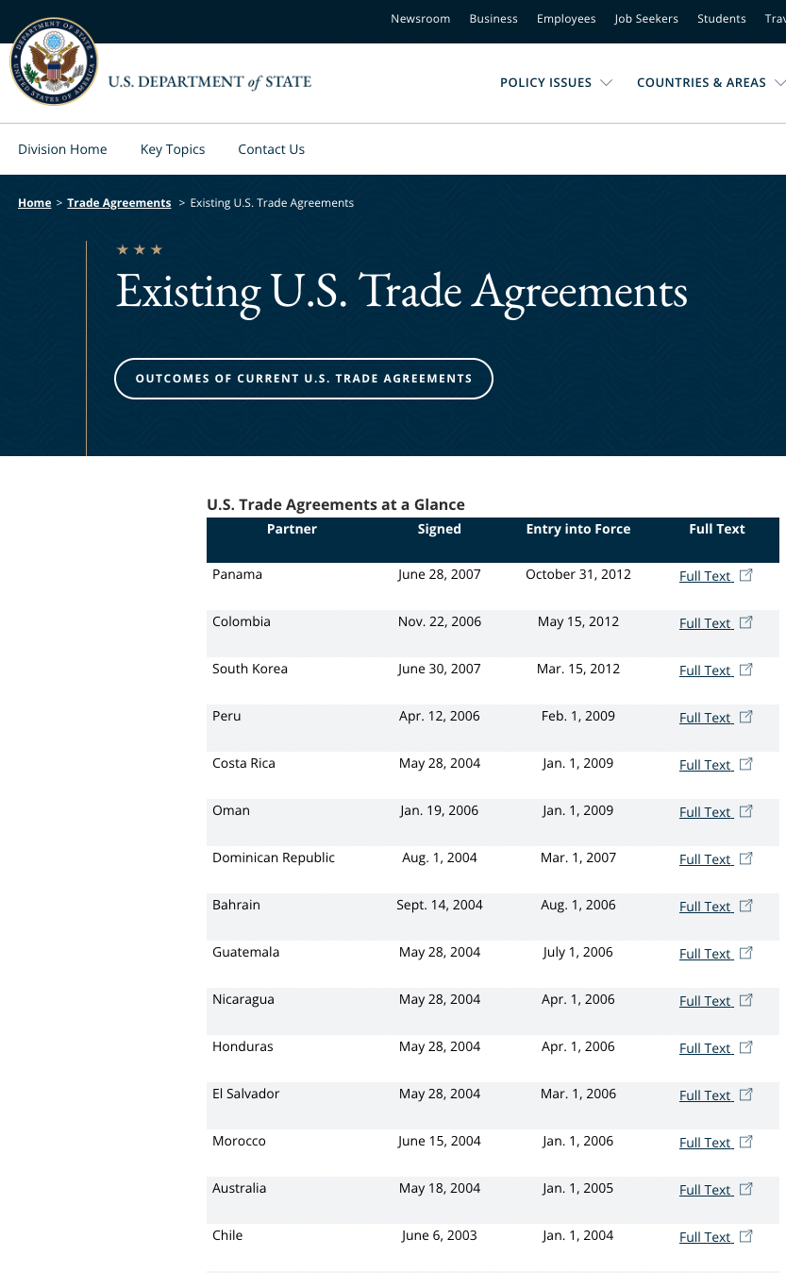
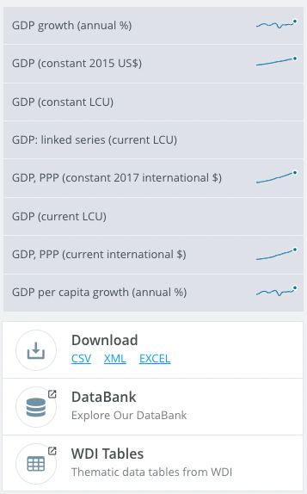
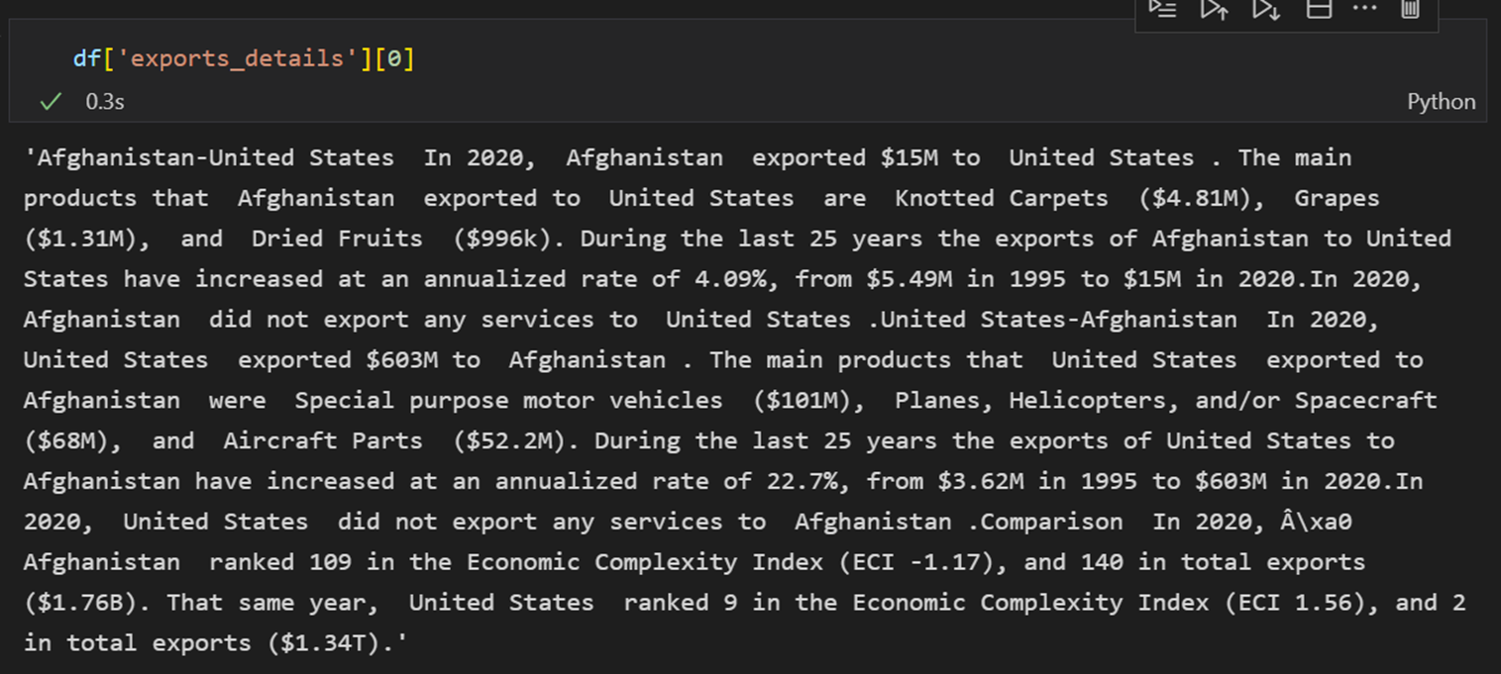
Preparation | Scraping Data
Different data sources required different data extraction mechanisms
Challenge - Crawling the dynamically loaded charts; ~35M records
Evaluated - Using spot checks, sum totals, counts, try-catch exception handling

Slide 6


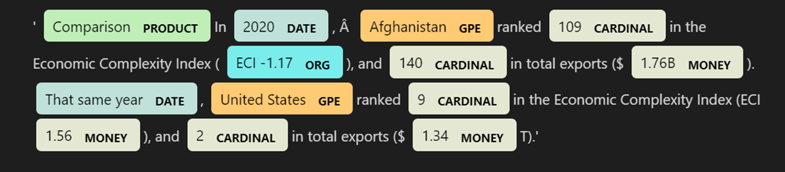
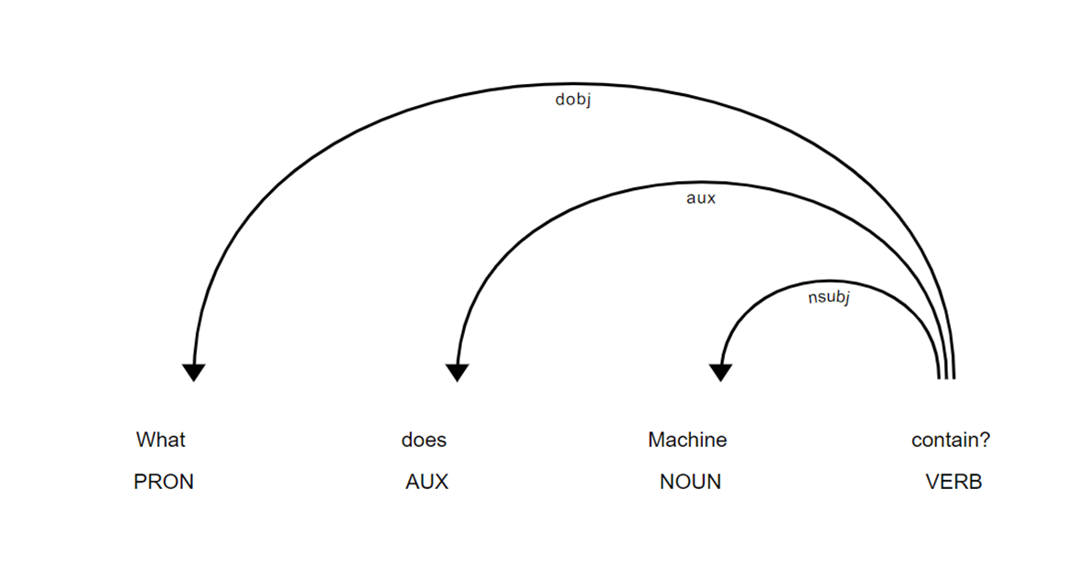
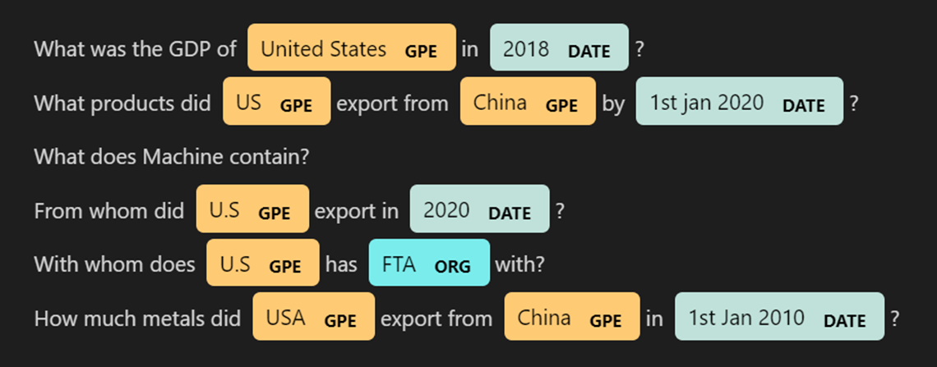
Preparation | Information Extraction
Textual/Link related extracted data required further processing
Rule based (lexical +syntactical)
For “Building KG” in Neo4j
For “Q&A module” in the App
Evaluation: Recognised patterns and keywords using spaCy; Manually checked the accuracy of those patterns for some records
Notes:
Date records, nan records, indexing, joining, roll up, pivot etc.

Slide 7

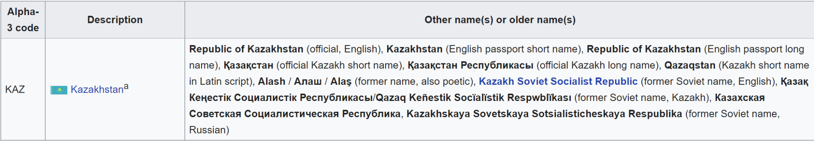
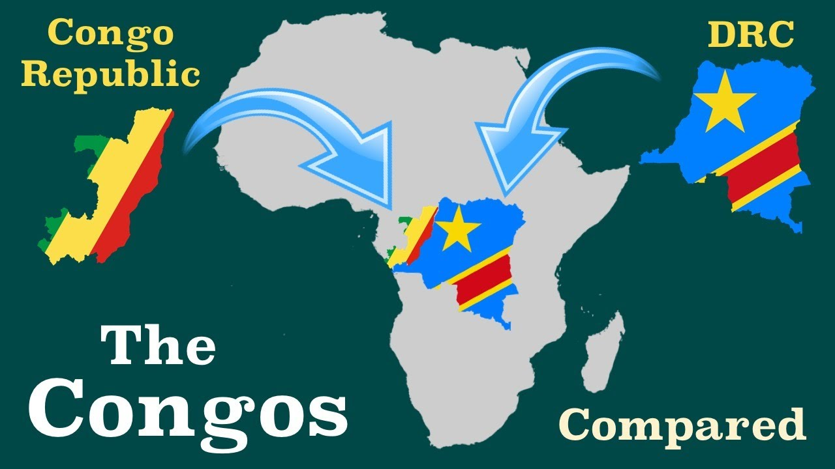


Preparation | Entity Linking (Similarity Measures)
Country related information from all sources was combined
Process: Blocking with Jaro and Dice Similarity
Initial accuracy score: 97.3% (Manually created the truth file)
Challenge: Alternative country names
Republic of Korea
DP’s Republic of Korea
Linked country names to ISO_3 std format (eg. AFG FOR Afghanistan)

Slide 8
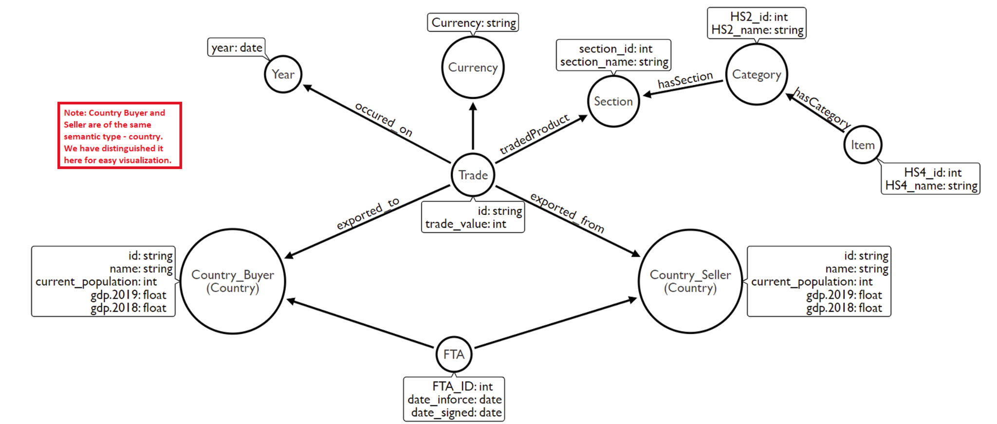
Preparation | Ontology
Handling the big data required efficient ontology design

Slide 9
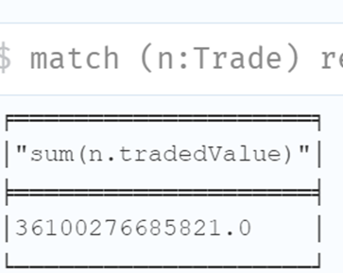
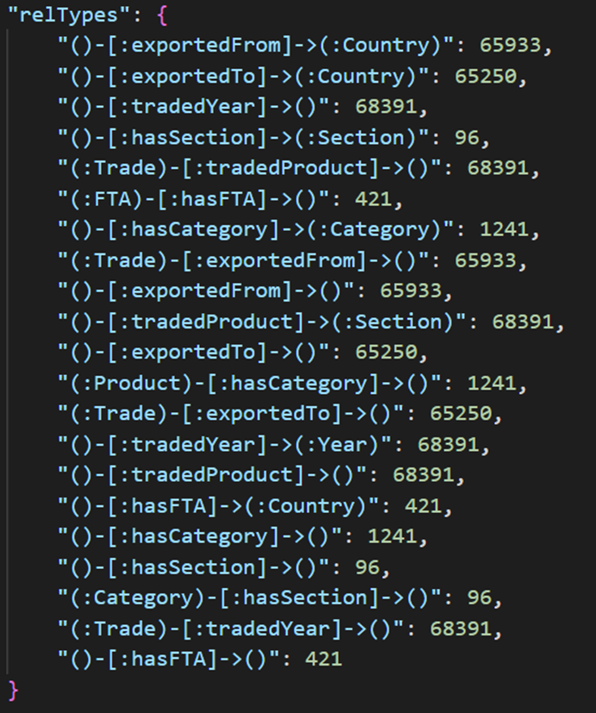
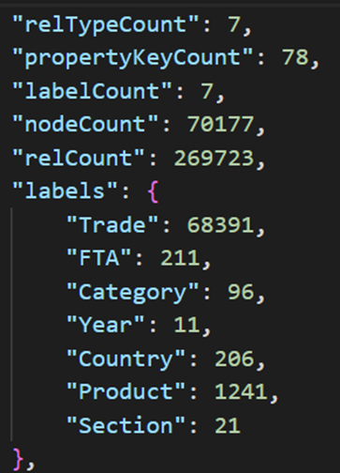
Preparation | KG Quality Assessment
By comparison of data summary in Neo4j KG with Raw data, we assure High Quality
Approach:
Manual approach: Mix of Subjective & Objective criteria
Verified:
Functional requirements - completeness and correctness
Non Functional requirements - Non redundant and consistent
5 Quality Dimensions:
Correctness
Completeness
Accuracy
Trustworthy
Interpretable
Notes:
Subjective - completeness and correctness
Objective - Based on clearly defined criteria

Slide 10
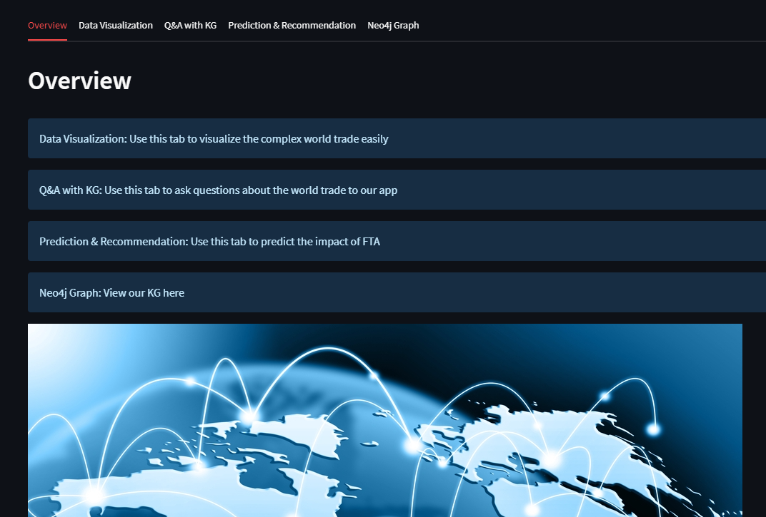
WebApp Design

Slide 11
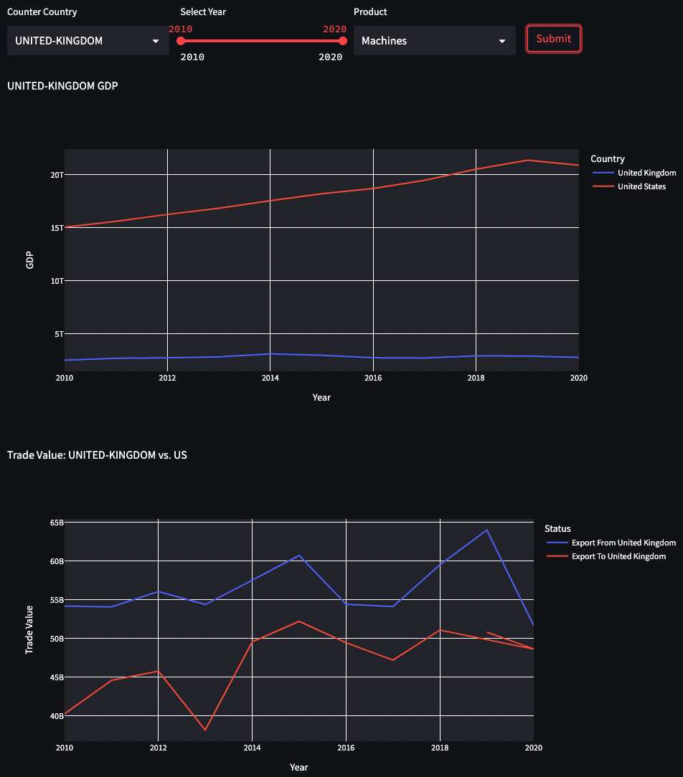
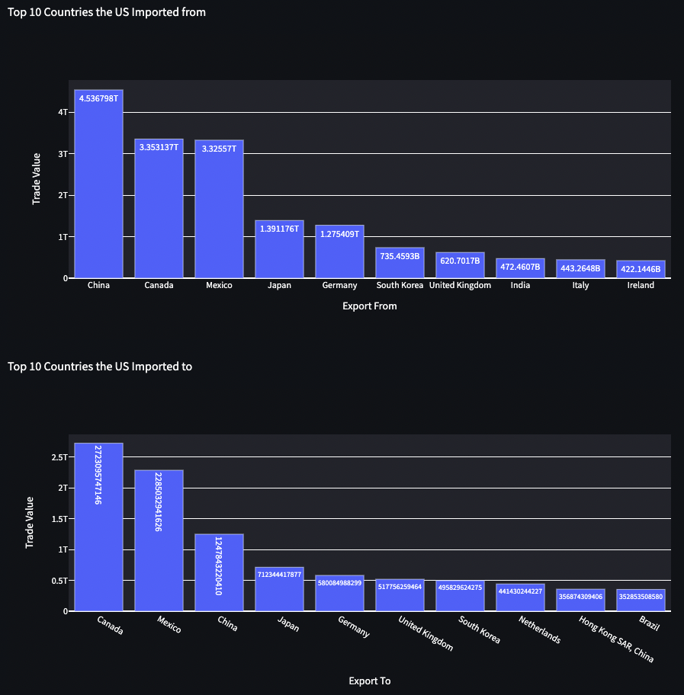
App | Data Visualization - Gross View
USA vs. Selected Country: GDP, Yearly Trade values, and Top 10 Trade countries

Slide 12
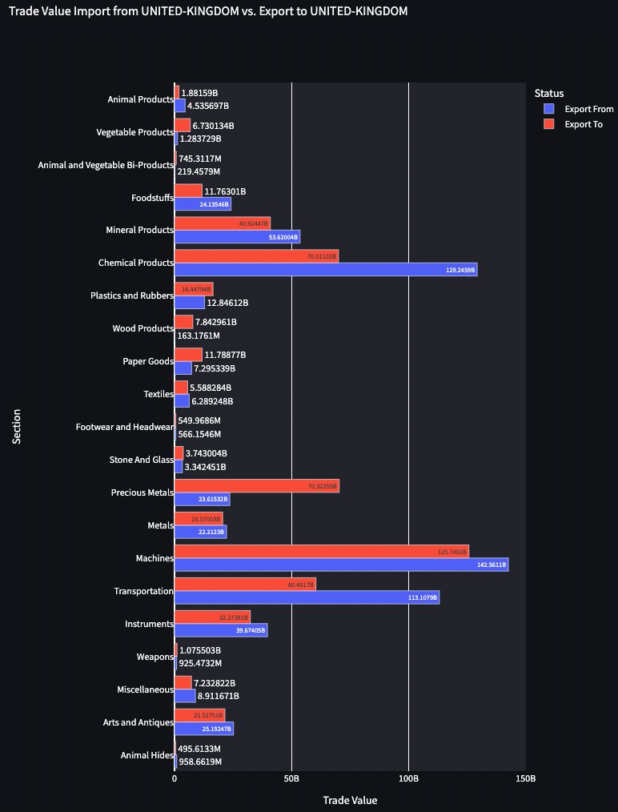
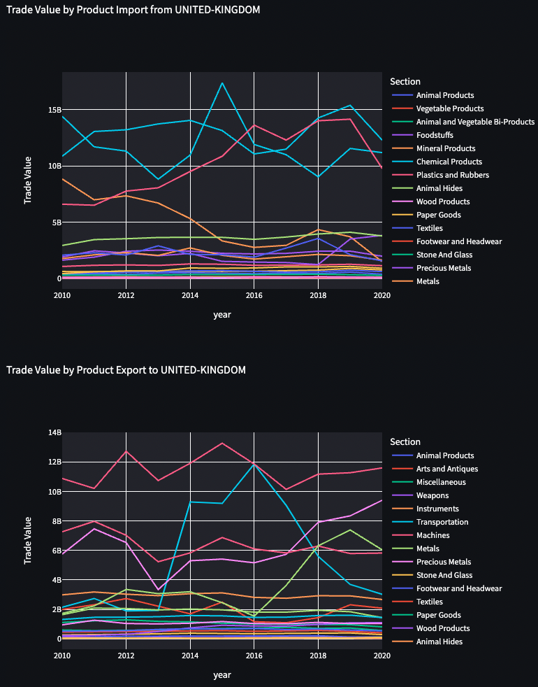
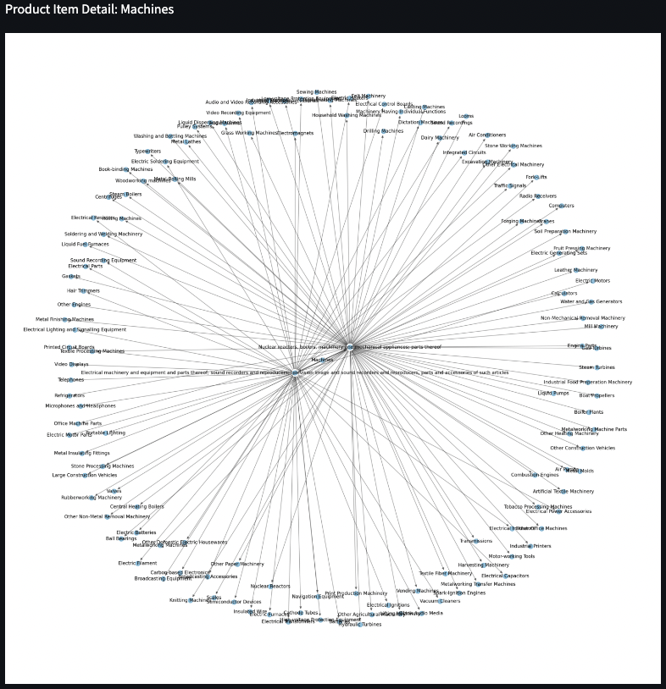
App | Data Visualization - Country Detail View
Selected country detail: Trade value for each product, Yearly value, Product Tree

Slide 13



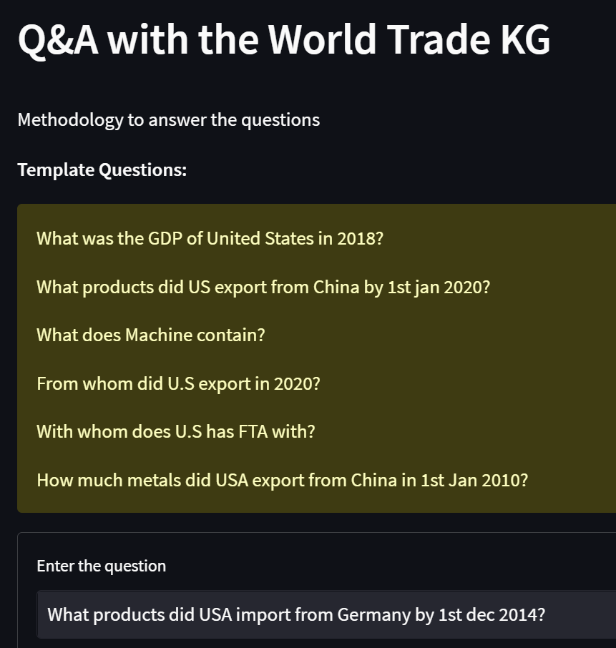
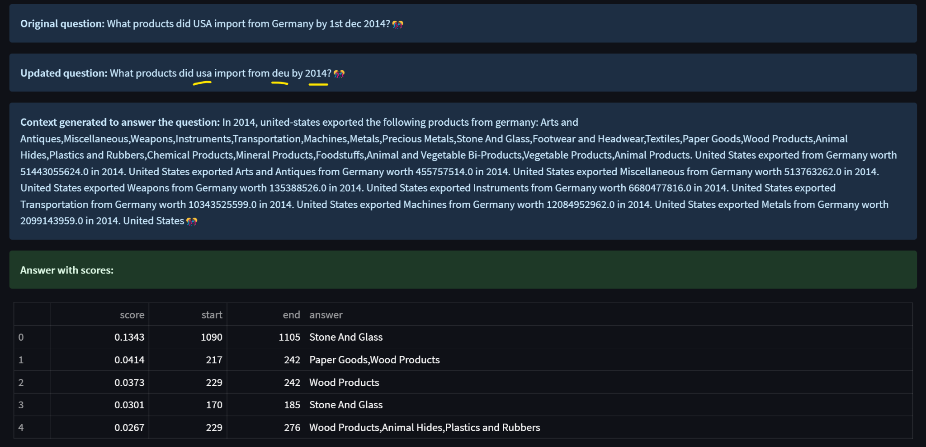
App | Q&A with the World Trade KG
A question is answered by building context using KG
Entering
a Question
Parsing and
Making Context
by Fetching Data
from KG
Finding an answer using Huggingface
Pre-trained model
Answering
the Question
with Score
Notes:
Information like country, year, or product is parsed and used to make context. With the context, we find the answer using Hugging face library.

Slide 14

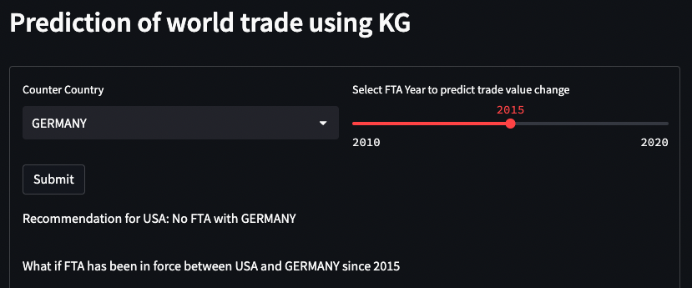
App | Prediction and Recommendation
ML Questions: Do we recommend FTA with a country? What if it is in force?
Enter
a Country
and FTA year
for Prediction
Build Test data
by fetching data
from KG
Load a pickled model for prediction
Show Result
Pre-trained by Reinforcement Regressor (scikit-learn)
Trained on history data
Model Validation: Using Grid search and Cross Validation (5-fold), R2 of the best estimator scored 0.85

Slide 15
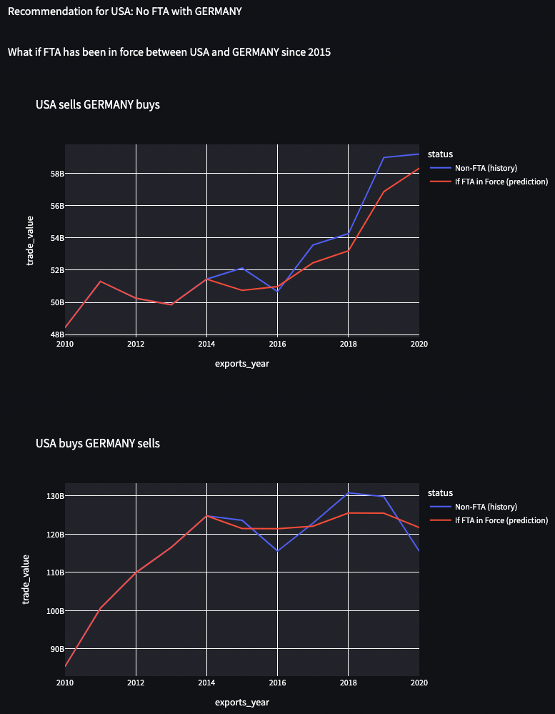
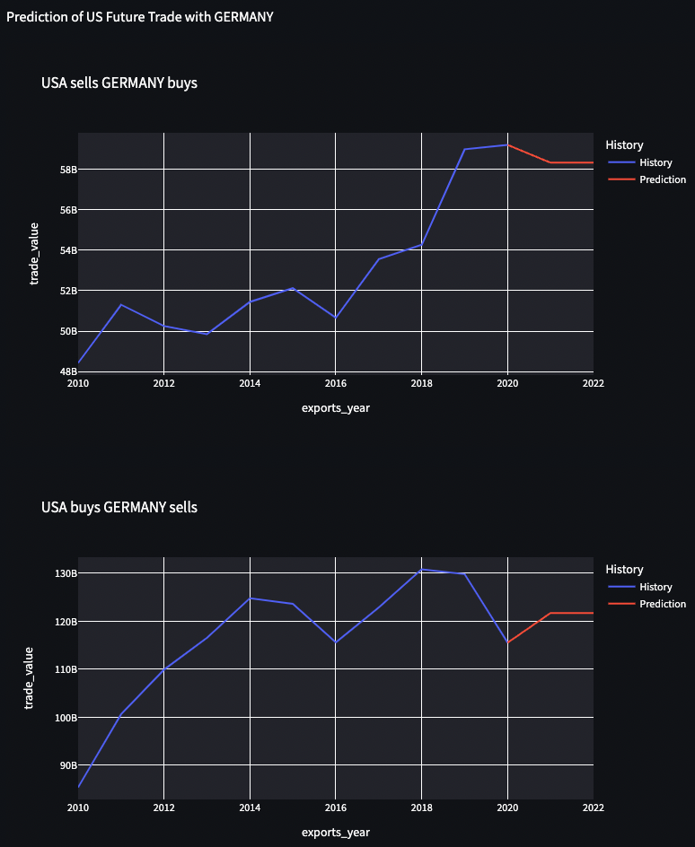


App | Prediction and Recommendation (cont.)
Example prediction: the model does not recommend “USA FTA with Germany”
vs.
Less Export value vs. Germany
Import value doesn’t go up or down dramatically
Future Export value goes downward
Future Import value goes upward

Slide 16
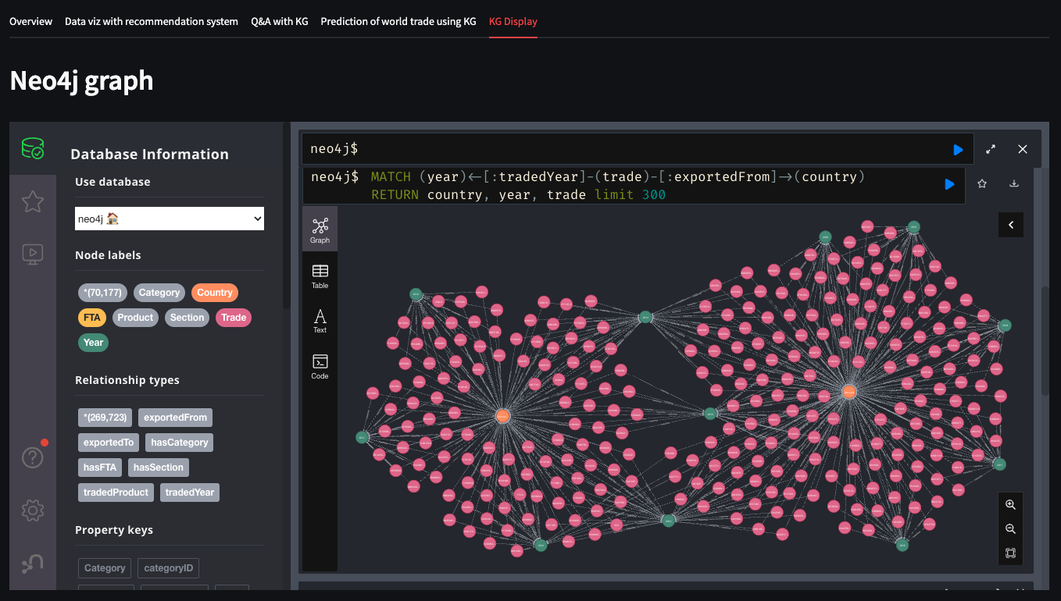
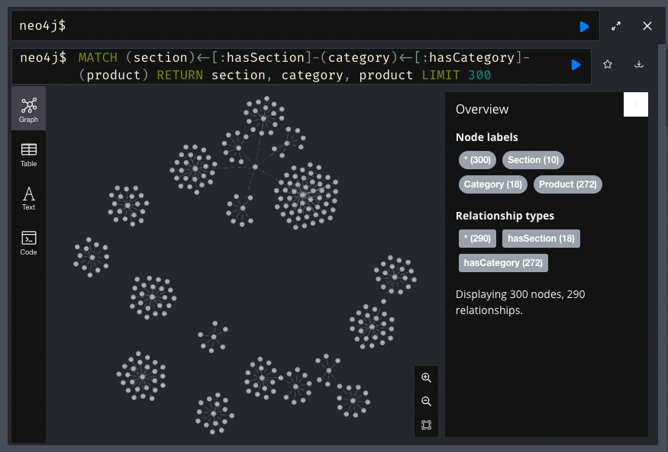
App | Neo4j Graph Visualization
70k nodes and 270k relationships are shown in KG
(year) -[:]-(trade)-[:]-(country) Nodes
(section) -[:]-(category)-[:]-(product) Nodes

Slide 17
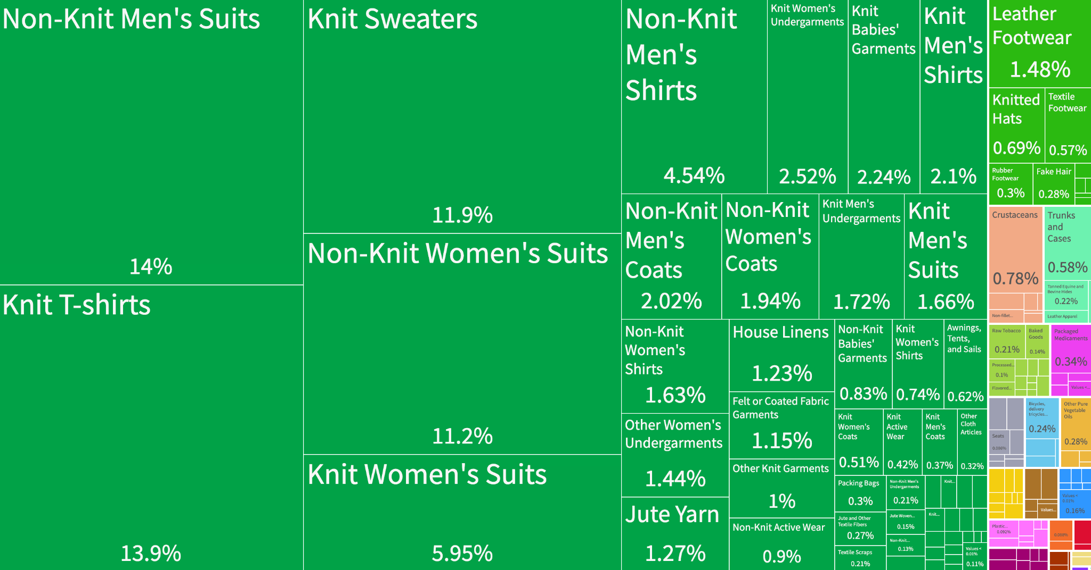
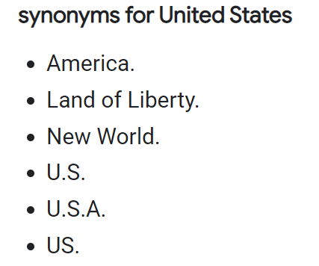

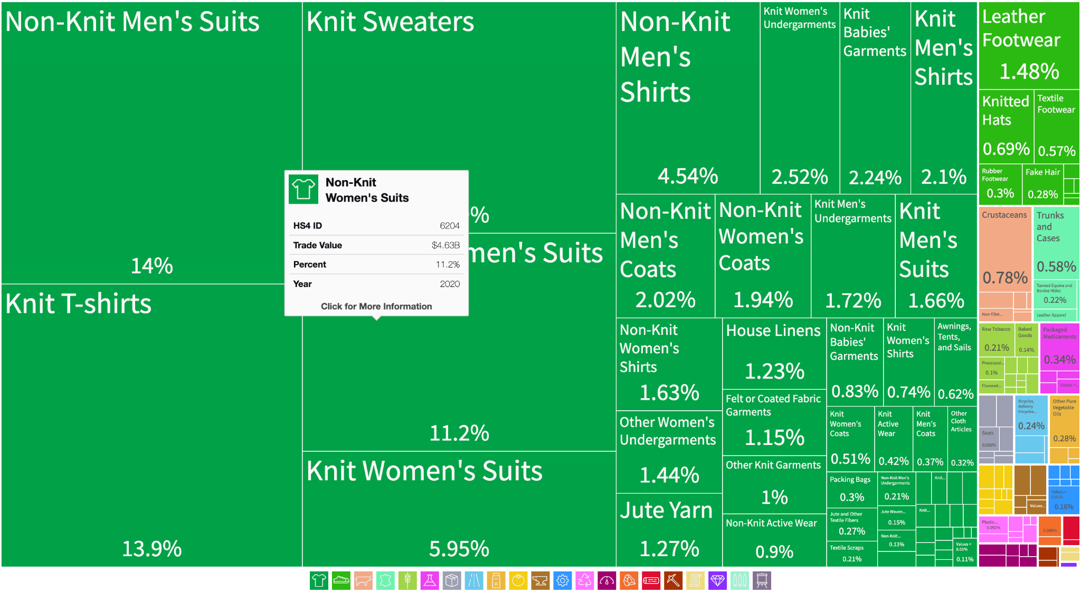
Challenge Summary 1 | Building KG DB
Scrawling Dynamic charts and links/ Unmatched country names
Data from Dynamic Charts/Links
Solution: Adding wait time & improvising regex
Alternative Country Names
Solution: Entity Linking
with manually updating mismatches
Notes:
Challenges 1: Building KG DB
Unmatched country names from different sources (entity linking)
Building KG DB (selecting the best way, data processing to fit the process)
Building ontology: how to design ontology (ex: country, buyer, seller - and their properties, how to combine each trade - buyer, seller, products …)
Buyer, Seller- figuring out the structure of ontology, self-join of countries

Slide 18

Challenge Summary 1 | Building KG DB (cont.)
Information extraction evaluation and Efficient ontology design
Evaluating Quality of Information extraction
Solution: Manually extracted the patterns
and Aligned to possible combinations
Designing Efficient Ontology
Solution: Adding unique identifier in KG
Trade
ID
Reuse
Buyer
Seller
Notes:
Challenges 1: Building KG DB
Unmatched country names from different sources (entity linking)
Building KG DB (selecting the best way, data processing to fit the process)
Building ontology: how to design ontology (ex: country, buyer, seller - and their properties, how to combine each trade - buyer, seller, products …)
Buyer, Seller- figuring out the structure of ontology, self-join of countries

Slide 19

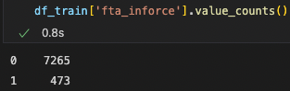
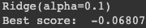
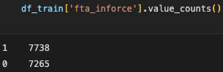
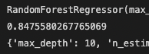
Challenge Summary 2 | Data size and quality
Too Large Dataset but Sparse Data for Machine Learning
Too Large Dataset
Sparse and Imbalanced Data with Inconsistent Trend
Imbalanced:
Initial Score:
More than 200 countries
For 20 years of Trade data
Too much time to scrawl
Not fit for Neo4j free tier
Scoping down
Blocking
Resampling of FTA in-force data
Cross validation with Grid search
Balanced:
Improved Score:
USA related Trades data
For the last 10 years
10 hrs to scrawl
15 hrs for Neo4j
Using
Neo4j free tier

Slide 20

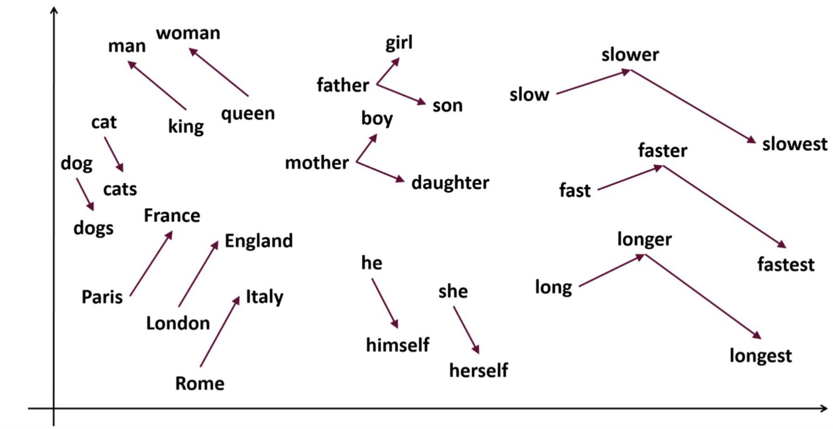
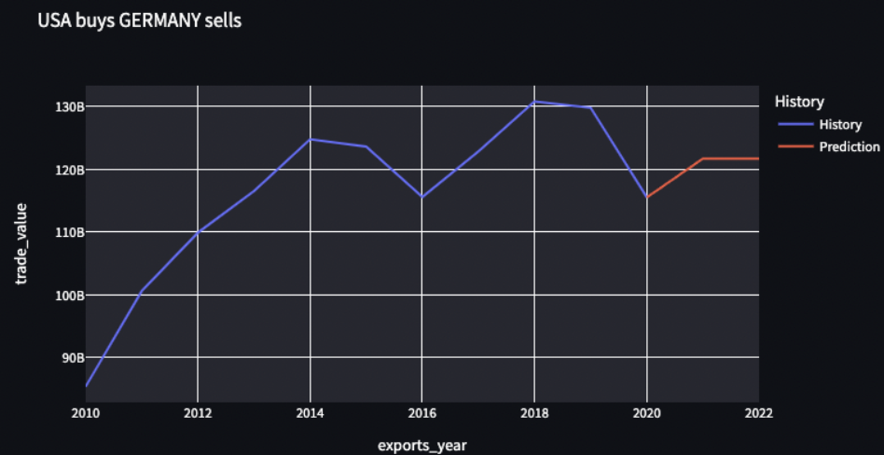

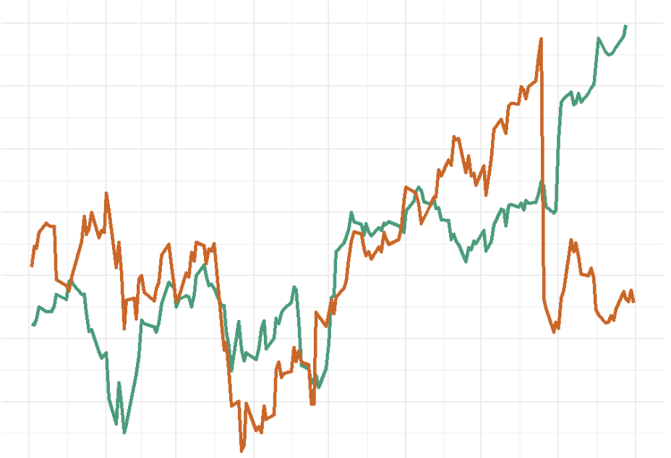
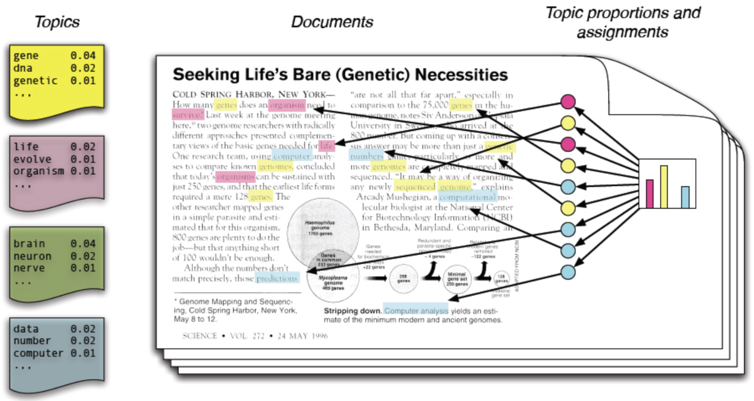
Further Research Points
Data
Embedding
Prediction
US related Yearly data
No Embedding used
Limited
Future prediction
World scope
Monthly data
Better Future prediction using Time series
Incorporating Embeddings
Notes:
World scope, Month data, Improvement in parsing and embeddings, Better prediction in ML

